Slide 1
Demo/Discussion:
Fit performance tests, benchmarking

Slide 2
Types of (automated) tests
Unit (C++)
Check for correct functionality
Quick (<< 1s)
All classes
Maybe not totally realistic (as far as “Quick” allows)
System (Python)
Less limited than unit tests
Real data, real reduction/processing of data
Doc tests (Python)
Usage examples (documentation) with expected output
Performance: particular case of unit tests
Measure computation time
Can (often should) take ~ a few seconds

Slide 3
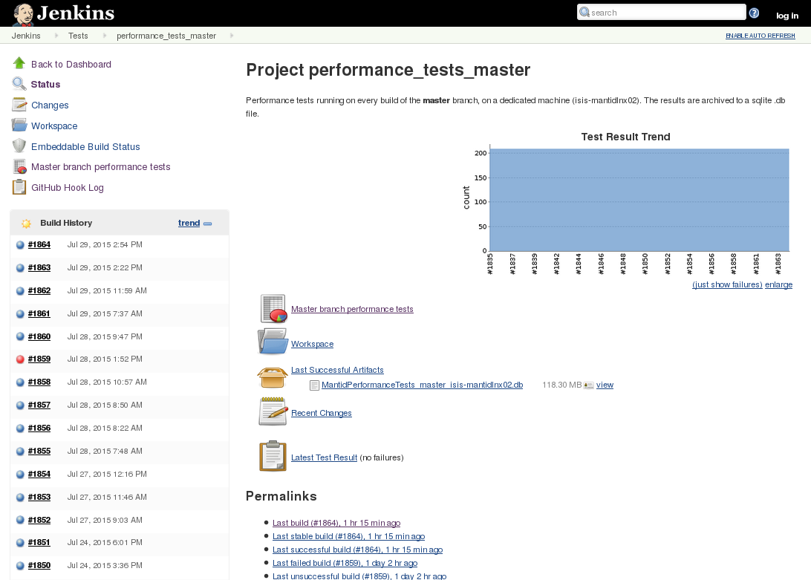
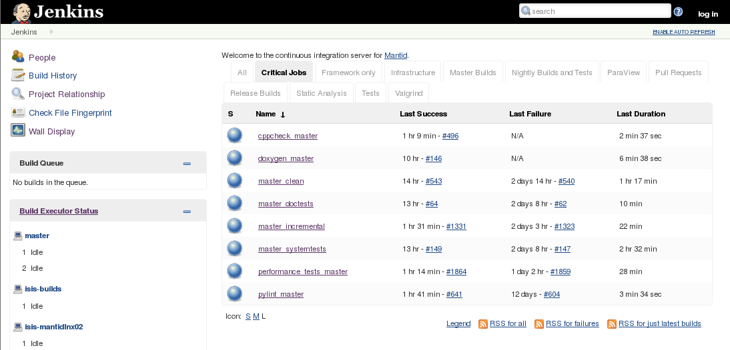
Automated performance tests builds.mantidproject.org

Slide 4
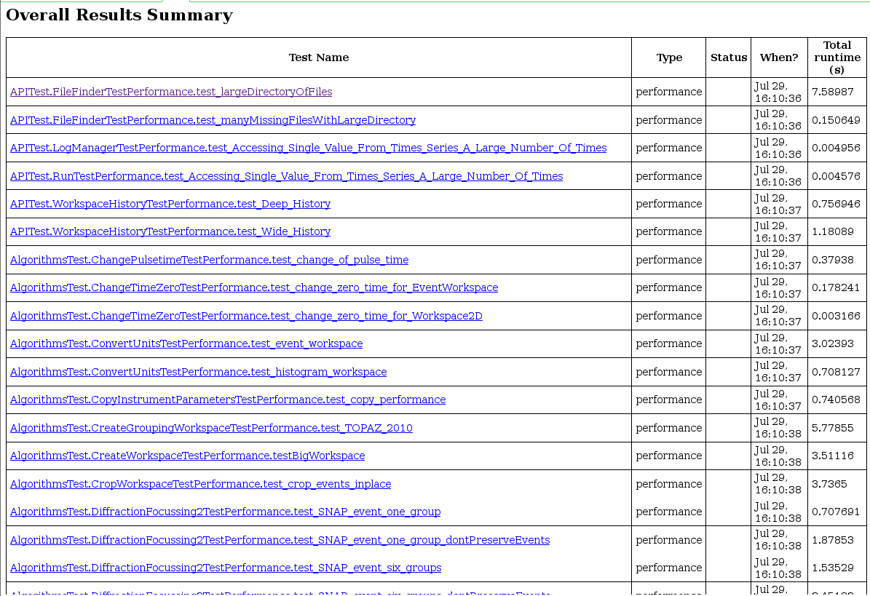
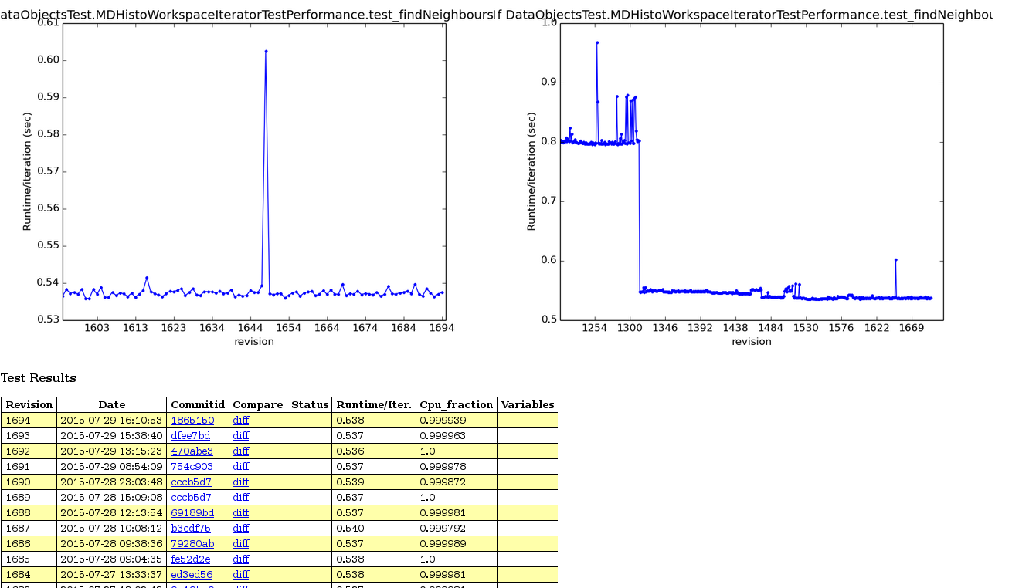
Automated performance tests http://builds.mantidproject.org

Slide 5
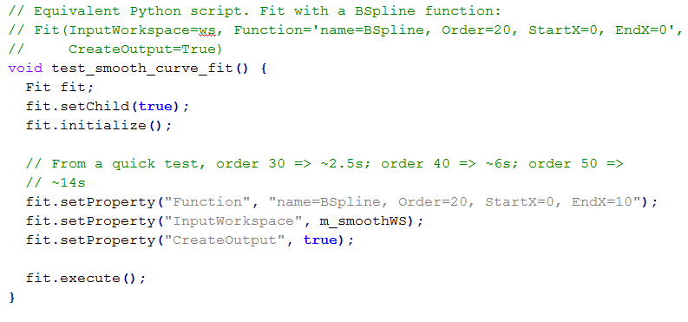
Example performance test
Code/Mantid/Framework/CurveFitting/test/FitTest.h
⁞

Slide 6
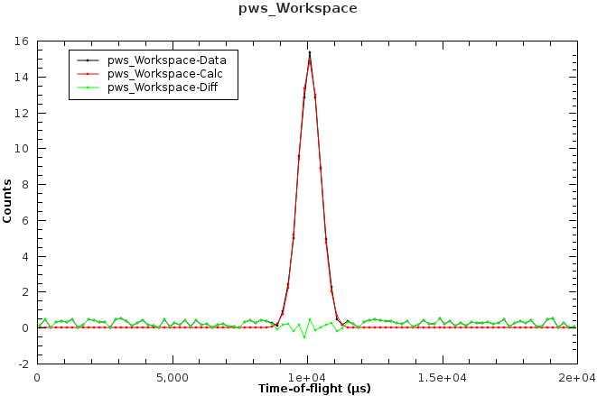
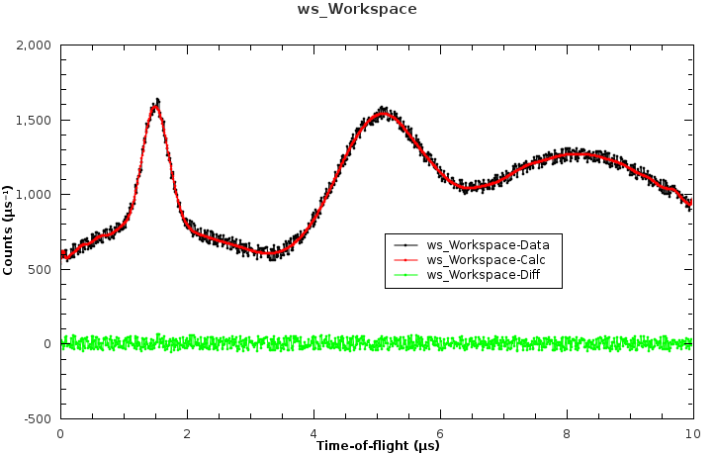
Example performance test
Code/Mantid/Framework/CurveFitting/test/FitTest.h
Peaks in spectra (histogram data)
Smoother shapes (sum of spectra)

Slide 7
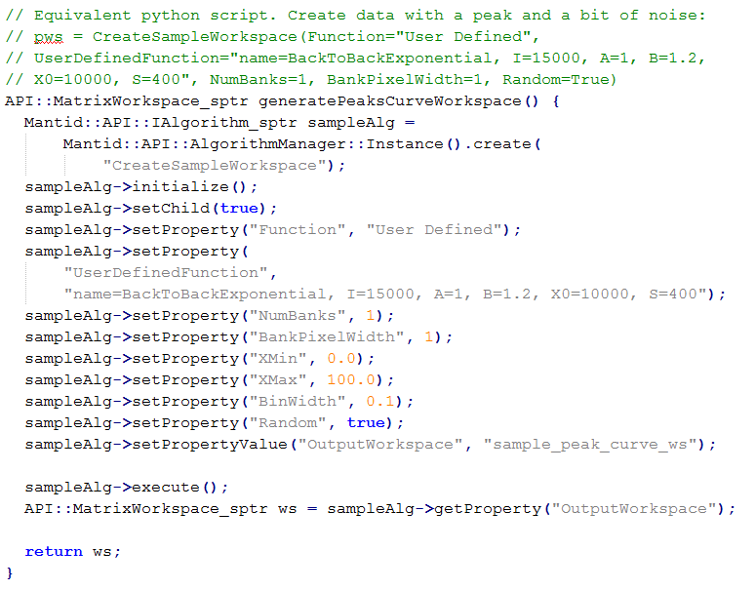
Example: generate performance test data

Slide 8
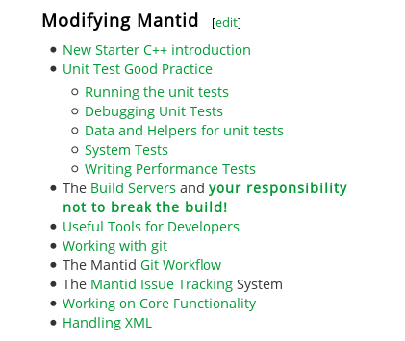
Performance tests: guidelines
Neither too fast nor too slow
Simply: unit tests with `Performance`
Track history
Automated email alerts (25% ↑) and weekly checks
Run:
$ ctest –R Performance
$ ctest –V –R <Name*>
$ ctest –V –R FitTestPerformance
Not sys tests – keep focused
Not unit tests – don’t need checks/asserts
Ideal range of time: 0.2-2s

